Slide 1
Introduction
SOFTWARE ENGINEERING
1

Slide 2
Software engineering
Software engineering is an engineering discipline that is concerned with all aspects of software production.
fundamental software engineering activities
  Software specification, software development, software validation and software evolution.
SOFTWARE ENGINEERING

Slide 3
System Engineering versus Software Engineering
System engineering is concerned with all aspects of computer-based systems development including hardware, software and process engineering.
Software engineering is part of this more general process.
SOFTWARE ENGINEERING

Slide 4
Software
Q : If you have to write a 10,000 line program in C to solve a problem, how long will it take?
Answers: generally range from 2-4 months
Let us analyze the productivity
  Productivity = output/input resources
  In SW output is considered as LOC
  Input resources is effort - person months; overhead cost modeled in rate for person month
  Though not perfect, some productivity measure is needed, as project has to keep it high
SOFTWARE ENGINEERING

Slide 5
Software …
The productivity is 2.5-5 KLOC/PM
Q: What is the productivity in a typical commercial SW organization ?
A: Between 100 to 1000 LOC/PM
Q: Why is it low, when your productivity is so high? (people like you work in the industry)
A: What the student is building and what the industry builds are two different things
SOFTWARE ENGINEERING

Slide 6
Software…
In a univ a student system is built while the commercial org builds industrial strength sw
What is the difference between a student program and industrial strength sw for the same problem?
Software (IEEE): collection of programs, procedures, rules, and associated documentation and data
SOFTWARE ENGINEERING

Slide 7
Software…
Student
Developer is the user
  bugs are tolerable
  UI not important
  No documentation
Industrial Strength
Others are the users
  bugs not tolerated
  UI v. imp. issue
  Documents needed for the user as well as for the organization and the project
SOFTWARE ENGINEERING

Slide 8
Software…
Student
SW not in critical use
Reliability, robustness not important
No investment
Don’t care about portability
Industrial Strength
Supports important functions / business
Reliability , robustness are very important
Heavy investment
Portability is a key issue here
SOFTWARE ENGINEERING

Slide 9
Industrial strength software
Student programs for a problem & industrial strength software are two different things
Key difference is in quality (including usability, reliability, portability, etc.)
Brooks thumb-rule: Industrial strength sw costs 10 time more than student sw
In this course, software means industrial strength software
This software has some characteristics
SOFTWARE ENGINEERING

Slide 10
Is Expensive
Let us look at costs involved
  Productivity = Appx 1000 LOC/PM
  Cost = $3K to $10K/PM
  Cost per LOC = $5 to $15
  i.e, each line of delivered code costs many $s
A simple application for a business may have 20KLOC to 50KLOC
  Cost = $100K to $2.25Million
  Can easily run on $10K-$20K hardware
  So HW costs in an IT solution are small as compared to SW costs.
SOFTWARE ENGINEERING

Slide 11
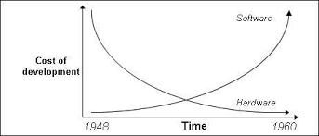
Softw
SOFTWARE ENGINEERING

Slide 12
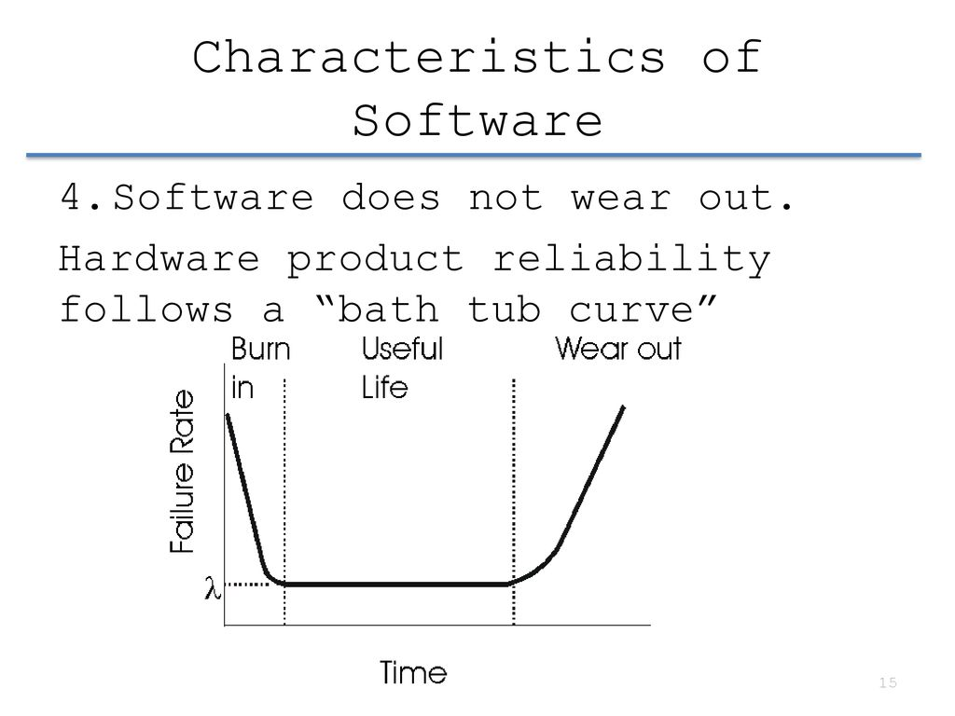

SOFTWARE ENGINEERING

Slide 13
Requires tight Schedule
Business requirements today demand short delivery times for software
In the past, software products have often failed to be completed in time
Along with cost, cycle time is a fundamental driving force
SOFTWARE ENGINEERING

Slide 14
Productivity – for cost and schedule
An industrial strength software project is driven by cost and schedule
Both can be modeled by productivity, measured in terms of output per unit effort (e.g. LOC per person month)
  Higher productivity leads to lower cost
  Higher productivity leads to lower cycle time
Hence, for projects (to deliver software), quality and productivity are basic drivers
SOFTWARE ENGINEERING

Slide 15
Quality
Along with productivity, quality is the other major driving factor
Developing high Q sw is a basic goal
Quality of sw is harder to define
SOFTWARE ENGINEERING

Slide 16
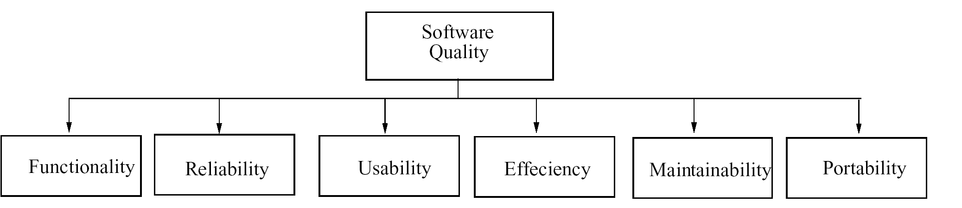
Quality – ISO standard
SOFTWARE ENGINEERING

Slide 17
Quality – ISO std…
ISO std has six attributes
  Functionality
  Reliability
  Usability
  Efficiency
  Maintainability
  Portability
SOFTWARE ENGINEERING

Slide 18
Quality…
Multiple dimensions mean that not easy to reduce Q to a single number
Concept of Q is project specific
  For some reliability is most important
  For others usability may be more important
Reliability is generally considered the main Q criterion
SOFTWARE ENGINEERING

Slide 19
Quality…
Reliability = Probability of failure
  hard to measure
  approximated by no. of defects in software
To normalize Quality we use Defect density
  Quality = No. of defects delivered / Size
Defects delivered - approximated with no. of defects found in operation
Current practices: less than 1 def/KLOC
What is a defect? Project specific!
SOFTWARE ENGINEERING

Slide 20
Quality – Maintainability
Once sw delivered, it enters the maintenance phase, in which
  Residual errors are fixed – this is corrective maintenance
  Upgrades and environment changes are done – this is adaptive maintenance
Maintenance can consume more effort than development over the life of the software (can even be 20:80 ratio!)
Hence maintainability is another quality attribute of great interest
SOFTWARE ENGINEERING

Slide 21
Quality and Productivity
Hence, quality and productivity (Q&P) are the basic drivers in a sw project
The aim of most methodologies is to deliver software with a high Q&P
Besides the need to achieve high Q&P there are some other needs
SOFTWARE ENGINEERING

Slide 22
Change
Only constant in business is change!
Requirements change, even while the project is in progress
In a project, up to 40% of development effort may go in implementing changes
So Practices are used for developing software must accommodate change
SOFTWARE ENGINEERING

Slide 23
Scale
Most industrial strength software tend to be large and complex
Methods for solving small problems do not often scale up for large problems
Two clear dimensions in a project
  engineering
  project management
For small, both can be done informally, for large both have to be formalized
SOFTWARE ENGINEERING

Slide 24
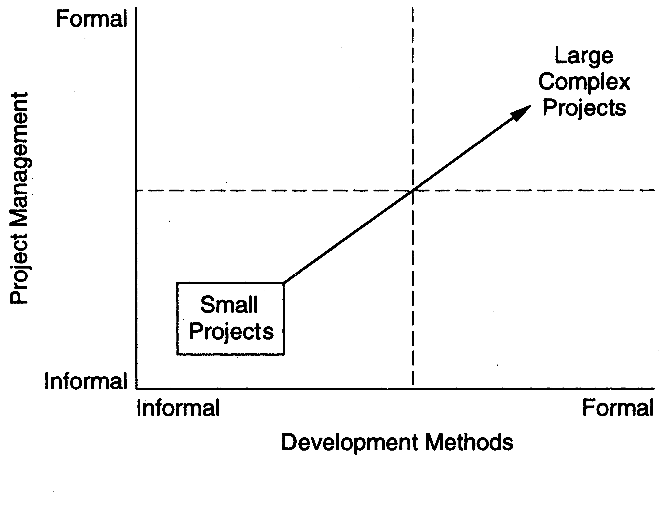
Scale…
SOFTWARE ENGINEERING

Slide 25
Scale…
An illustration of issue of scale is counting the number of people in a room vs taking a census
  Both are counting problems
  Methods used in first not useful for census
  For large scale counting problem, must use different techniques and models
  Management will become critical
SOFTWARE ENGINEERING

Slide 26
Scale…
As industry strength software tends to be large, hence methods used for building these must be able to scale up
For much of the discussion, we will high Q&P as the basic objective
SOFTWARE ENGINEERING

Slide 27
Software engineering
The economies of ALL developed nations are dependent on software.
More and more systems are software controlled
Software engineering is concerned with theories, methods and tools for professional software development.
SOFTWARE ENGINEERING

Slide 28
Software project failure
Increasing system complexity
Failure to use software engineering methods
  It is fairly easy to write computer programs without using software engineering methods and techniques.
  They do not use software engineering methods in their everyday work.
  Consequently, their software is often more expensive and less reliable than it should be.
  It is usually cheaper to use software engineering methods and techniques, in the long run
SOFTWARE ENGINEERING

Slide 29
Software products
Generic products
  Stand-alone systems that are marketed and sold to any customer who wishes to buy them.
  Examples – PC software such as graphics programs, project management tools; CAD software; software for specific markets such as appointments systems for dentists.
Customized products
  Software that is commissioned by a specific customer to meet their own needs.
  Examples – inventory control systems, embedded control systems, air traffic control software, traffic monitoring systems.
SOFTWARE ENGINEERING

Slide 30
Product specification
Generic products
  The specification of what the software should do is owned by the software developer and decisions on software change are made by the developer.
Customized products
  The specification of what the software should do is owned by the customer for the software and they make decisions on software changes that are required.
SOFTWARE ENGINEERING

Slide 31
Software process activities
Software specification, where customers and engineers define the software that is to be produced and the constraints on its operation.
Software development, where the software is designed and programmed.
Software validation, where the software is checked to ensure that it is what the customer requires.
Software evolution, where the software is modified to reflect changing customer and market requirements.
SOFTWARE ENGINEERING

Slide 32
General issues that affect software
Heterogeneity
  Increasingly, systems are required to operate as distributed systems across networks that include different types of computer and mobile devices.
Business and social change
  Business and society are changing incredibly quickly as emerging economies develop and new technologies become available. They need to be able to change their existing software and to rapidly develop new software.
SOFTWARE ENGINEERING

Slide 33
General issues that affect software
Security and trust
  As software is intertwined with all aspects of our lives, it is essential that we can trust that software.
Scale
  Software has to be developed across a very wide range of scales, from very small embedded systems in portable or wearable devices through to Internet-scale, cloud-based systems that serve a global community.
SOFTWARE ENGINEERING

Slide 34
Software engineering diversity
There are many different types of software system and there is no universal set of software techniques that is applicable to all of these.
The software engineering methods and tools used depend on the type of application being developed, the requirements of the customer and the background of the development team.
SOFTWARE ENGINEERING

Slide 35
Application types
Stand-alone applications
  These are application systems that run on a local computer, such as a PC. They include all necessary functionality and do not need to be connected to a network.
Interactive transaction-based applications
  Applications that execute on a remote computer and are accessed by users from their own PCs or terminals. These include web applications such as e-commerce applications.
SOFTWARE ENGINEERING

Slide 36
Application types
Embedded control systems
  These are software control systems that control and manage hardware devices. Numerically, there are probably more embedded systems than any other type of system.
Batch processing systems
  These are business systems that are designed to process data in large batches. They process large numbers of individual inputs to create corresponding outputs. Examples are beverage processing systems, food processing systems, soap manufacturing systems
SOFTWARE

Slide 37
Application types
Entertainment systems
  These are systems that are primarily for personal use and which are intended to entertain the user.
Systems for modeling and simulation
  These are systems that are developed by scientists and engineers to model physical processes or situations, which include many, separate, interacting objects.
SOFTWARE ENGINEERING

Slide 38
Application types
Data collection systems
  These are systems that collect data from their environment using a set of sensors and send that data to other systems for processing.
Systems of systems
  These are systems that are composed of a number of other software systems.
SOFTWARE ENGINEERING

Slide 39
Software engineering fundamentals
Some fundamental principles apply to all types of software system, irrespective of the development techniques used:
  Systems should be developed using a managed and understood development process. Of course, different processes are used for different types of software.
  Dependability and performance are important for all types of system.
  Understanding and managing the software specification and requirements (what the software should do) are important.
  Where appropriate, you should reuse software that has already been developed rather than write new software.
SOFTWARE ENGINEERING

Slide 40
Summary
The problem domain for SE is industrial strength software
SE aims to provide methods for systematically developing (industrial strength) software
Besides developing software the goal is to achieve high quality and productivity (Q&P)
Methods used must accommodate changes, and must be able to handle large problems
SOFTWARE ENGINEERING

Slide 41
Summary
key challenges facing software engineering
  Coping with increasing diversity, demands for reduced delivery times and developing trustworthy software
SOFTWARE ENGINEERING

Slide 42
Software engineering
Software engineering is an engineering discipline that is concerned with all aspects of software production from the early stages of system specification through to maintaining the system after it has gone into use.
SOFTWARE ENGINEERING

